Slide 1
Confounding factors
Day 3 - Lecture 2
Anna Tigano, Ph.D.

Slide 2
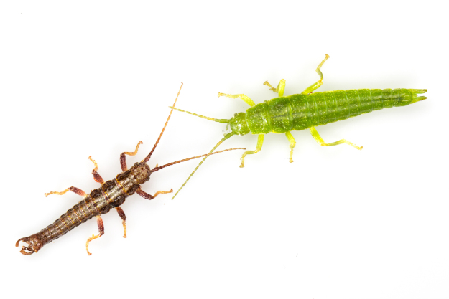
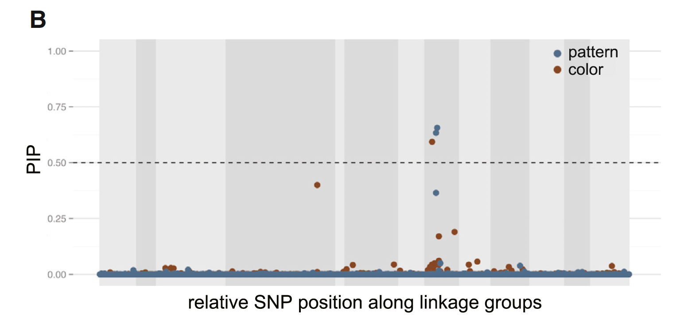
Expectation
Selection increases the frequency of beneficial mutations, so that when we compare two populations adapted to different local conditions we should see a difference in frequency at the locus underpinning that adaptive trait.
Moritz Muschick
Comeault et al. 2015, Current Biology

Slide 3
Yesterday I presented on the factors that contribute to our ability to detect signatures of a selective sweep in the genome.
However, that was a simple scenario, only one of many possible, and often more complex, scenarios.

Slide 4
Linked selection
Due to linked selection, several sites in close proximity to the real target of selection could show high F_{ST.}
1
F_{ST}
0
Position in the genome

Slide 5
Linked selection
Due to linked selection, several sites in close proximity to the real target of selection could show high F_{ST.}
1
With whole genome data, it is likely that you will genotype all, or most, of these sites with high F_{ST.}
F_{ST}
0
Position in the genome

Slide 6
Linked selection
Due to linked selection, several sites in close proximity to the real target of selection could show high F_{ST.}
1
With whole genome data, it is likely that you will genotype all, or most, of these sites with high F_{ST.}
The tighter linkage is, the harder is to disentangle target from linked sites.
F_{ST}
0
Position in the genome

Slide 7
Linked selection
Due to linked selection, several sites in close proximity to the real target of selection could show high F_{ST.}
1
With reduced-representation approaches, you won’t.
F_{ST}
0
Position in the genome

Slide 8
Linked selection
Due to linked selection, several sites in close proximity to the real target of selection could show high F_{ST.}
1
With reduced-representation approaches, you won’t.
Your F_{ST} outlier could be the real target of selection, or a neutral sites linked to it.
F_{ST}
0
Position in the genome

Slide 9
Positive selection
Natural selection = positive selection
→ Increases frequency of beneficial mutations

Slide 10
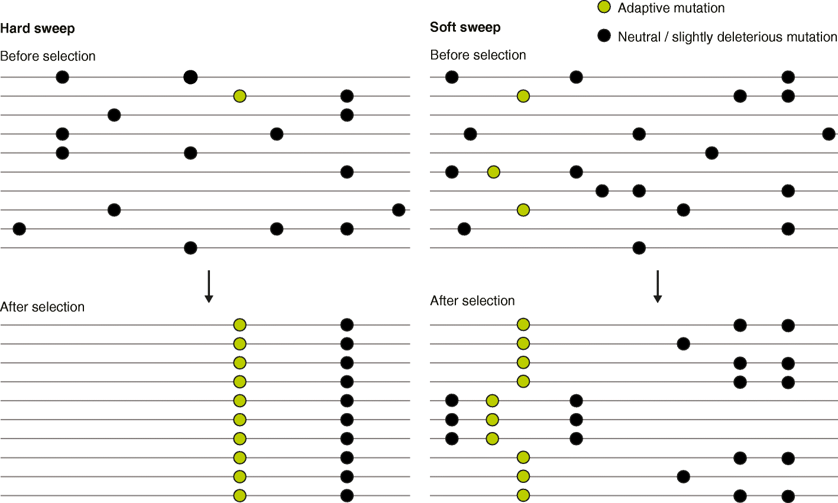
Hard vs. soft sweeps
Different mutations and/or different genomic backgrounds
One mutation on one genomic background

Slide 11
Balancing selection
Balancing selection maintains multiple alleles in the gene pool of a population at frequencies larger than expected from genetic drift alone.
Mechanisms:
Heterozygote advantage
Frequency-dependent selection
Spatially and/or temporally varying selection

Slide 12
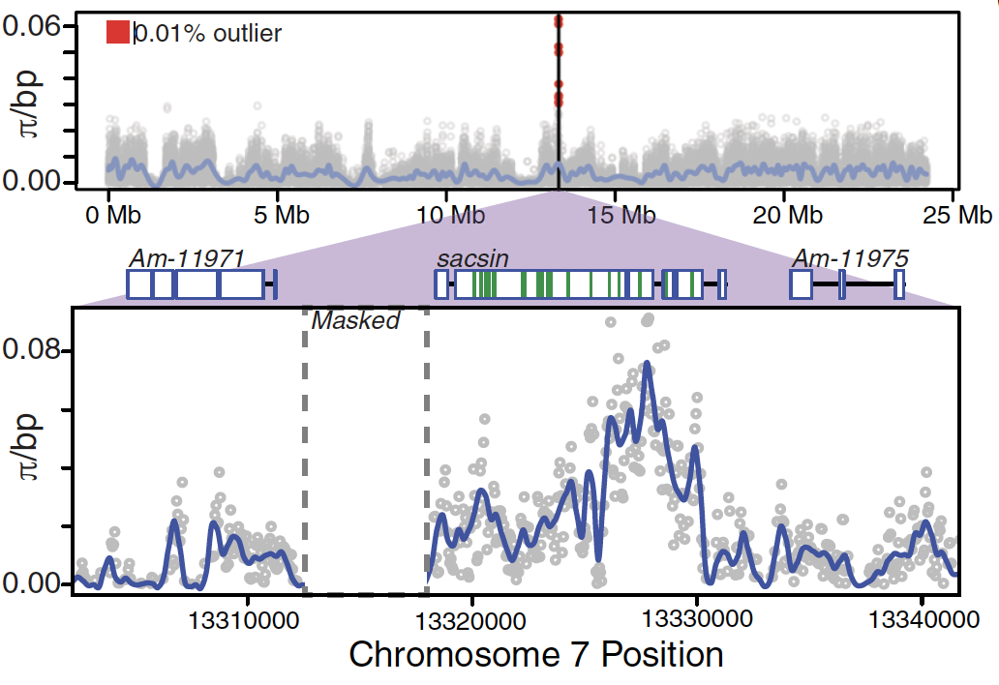
Signature of balancing selection
Higher genetic diversity at the locus under balancing selection
Fuller et al. 2020, Science

Slide 13
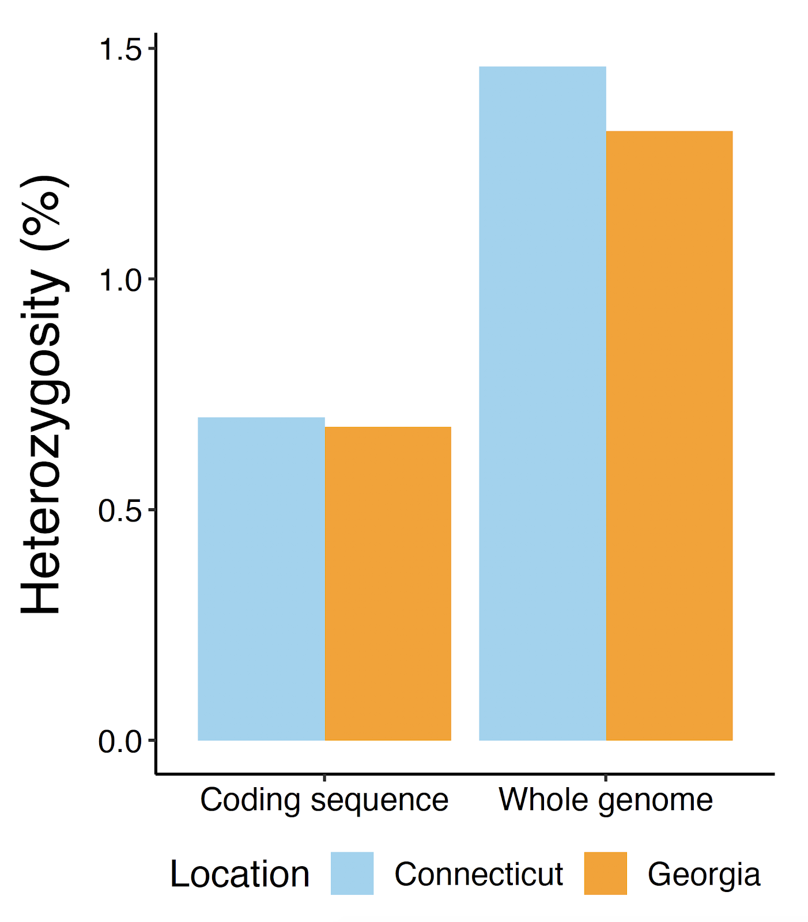
Background selection
Negative selection = purifying selection = background selection
Removes alleles that are deleterious
Similarly to positive selection, negative selection reduces diversity around the deleterious mutations under selection.
Protein-coding regions, for example, are under strict functional constraints and purifying selection is what keeps them functional.
Tigano et al., in prep

Slide 14
Could background selection generate the same genomic islands of differentiation as positive selection?

Slide 15
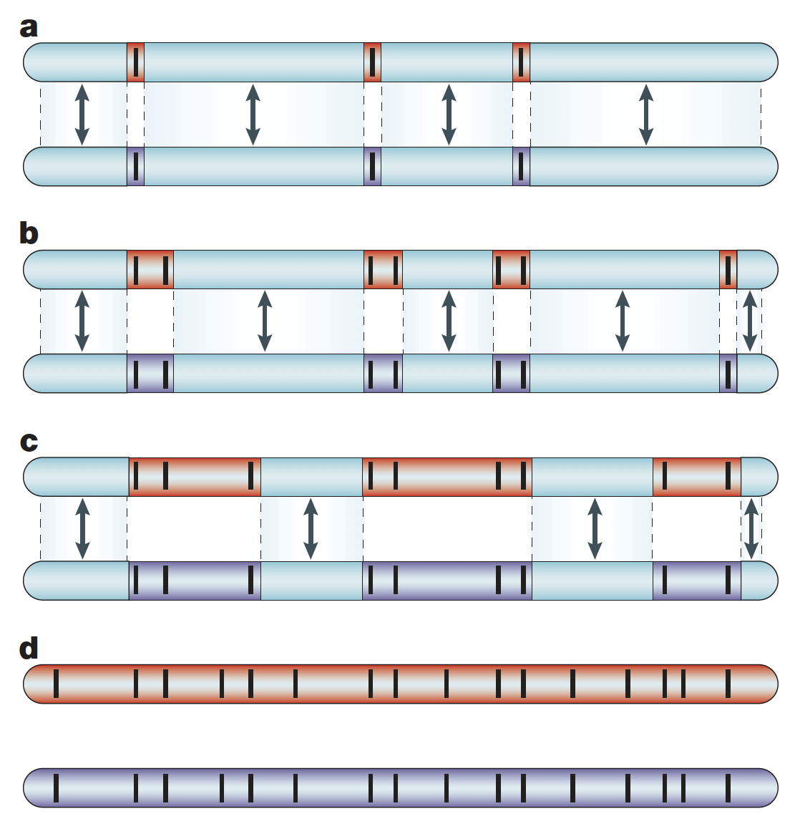
Genomic islands of differentiation
The speciation-with-gene-flow model is based on the genic view of speciation by Wu (2001)
Wu and Ting 2004, Nat. Gen. Rev.

Slide 16
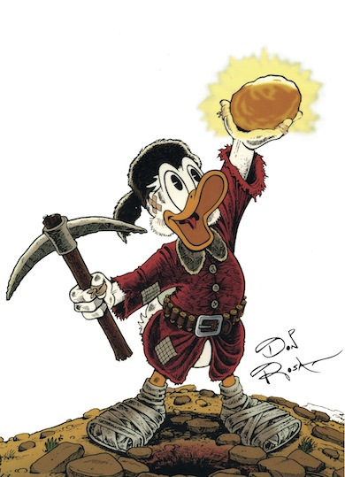
Genomic islands of differentiation
The speciation-with-gene-flow model is based on the genic view of speciation by Wu (2001)
Speciation/adaptation
genes
Wu and Ting 2004, Nat. Gen. Rev.

Slide 17
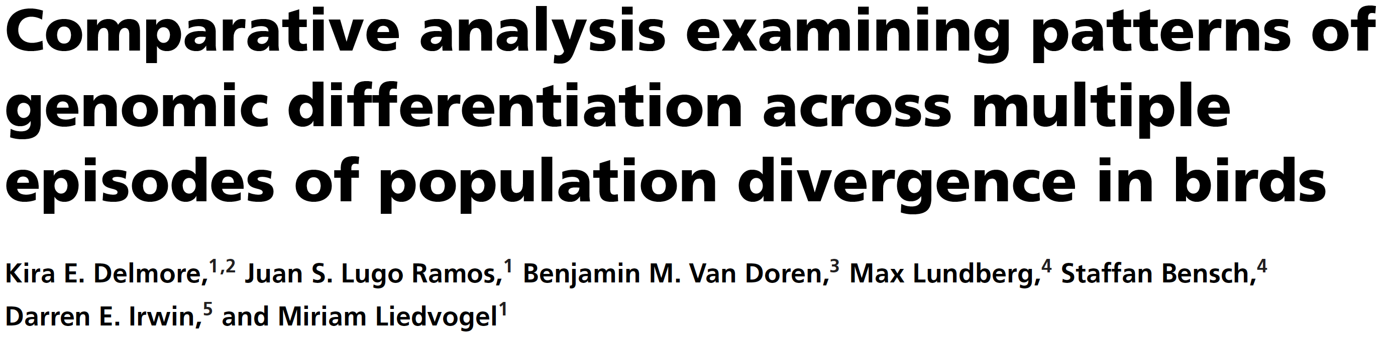
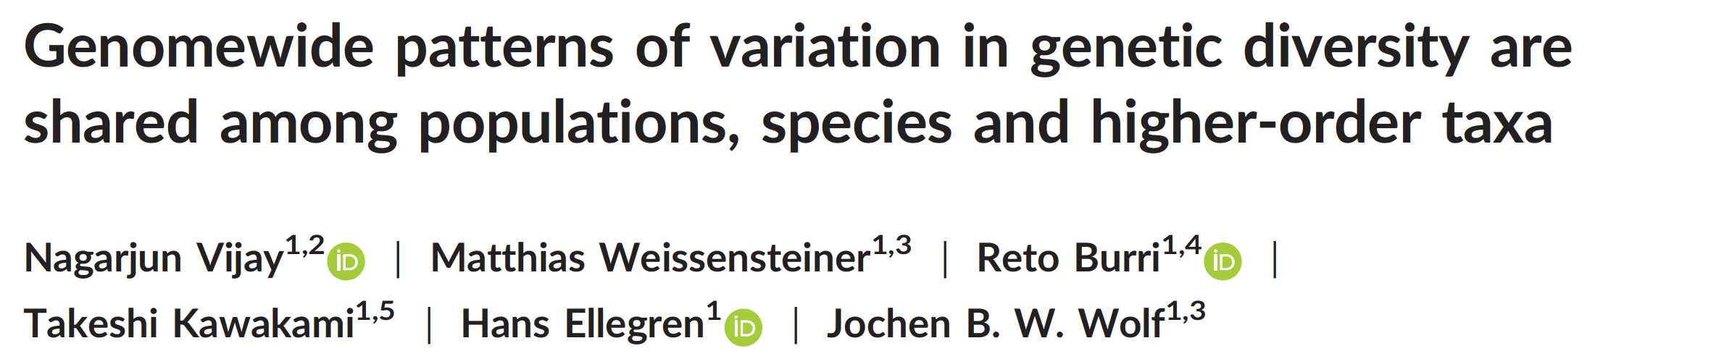
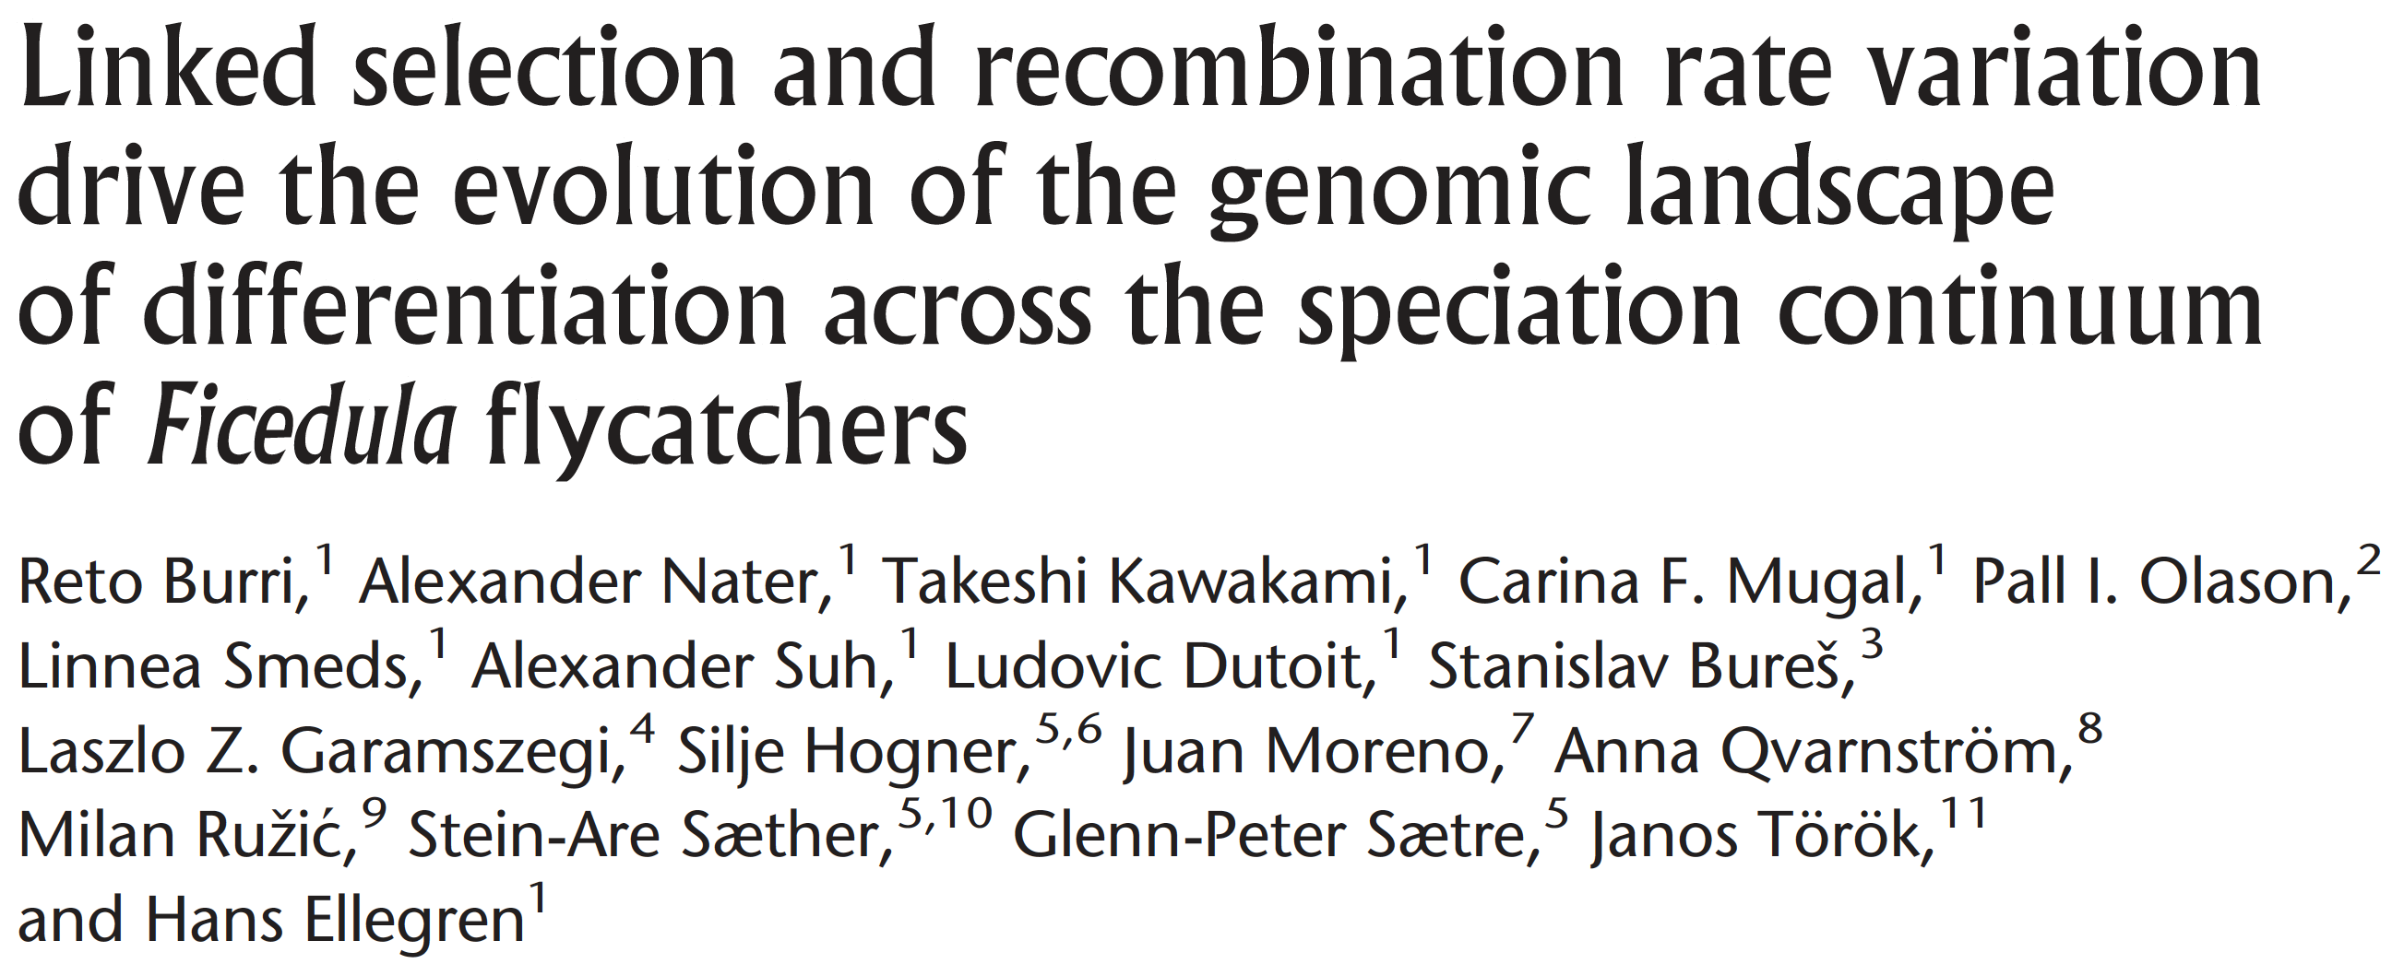
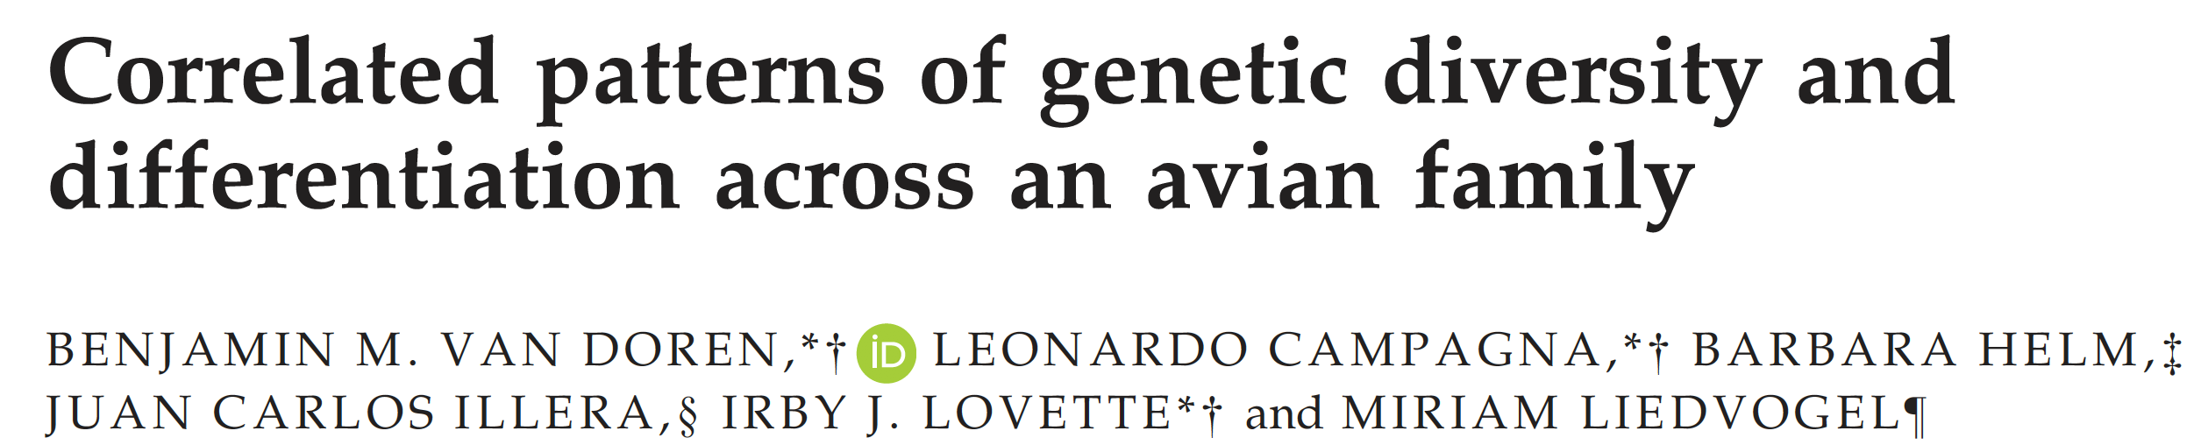
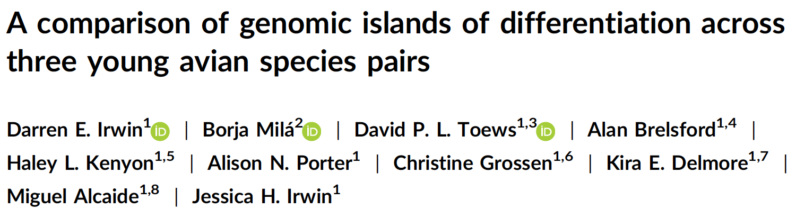

Slide 18
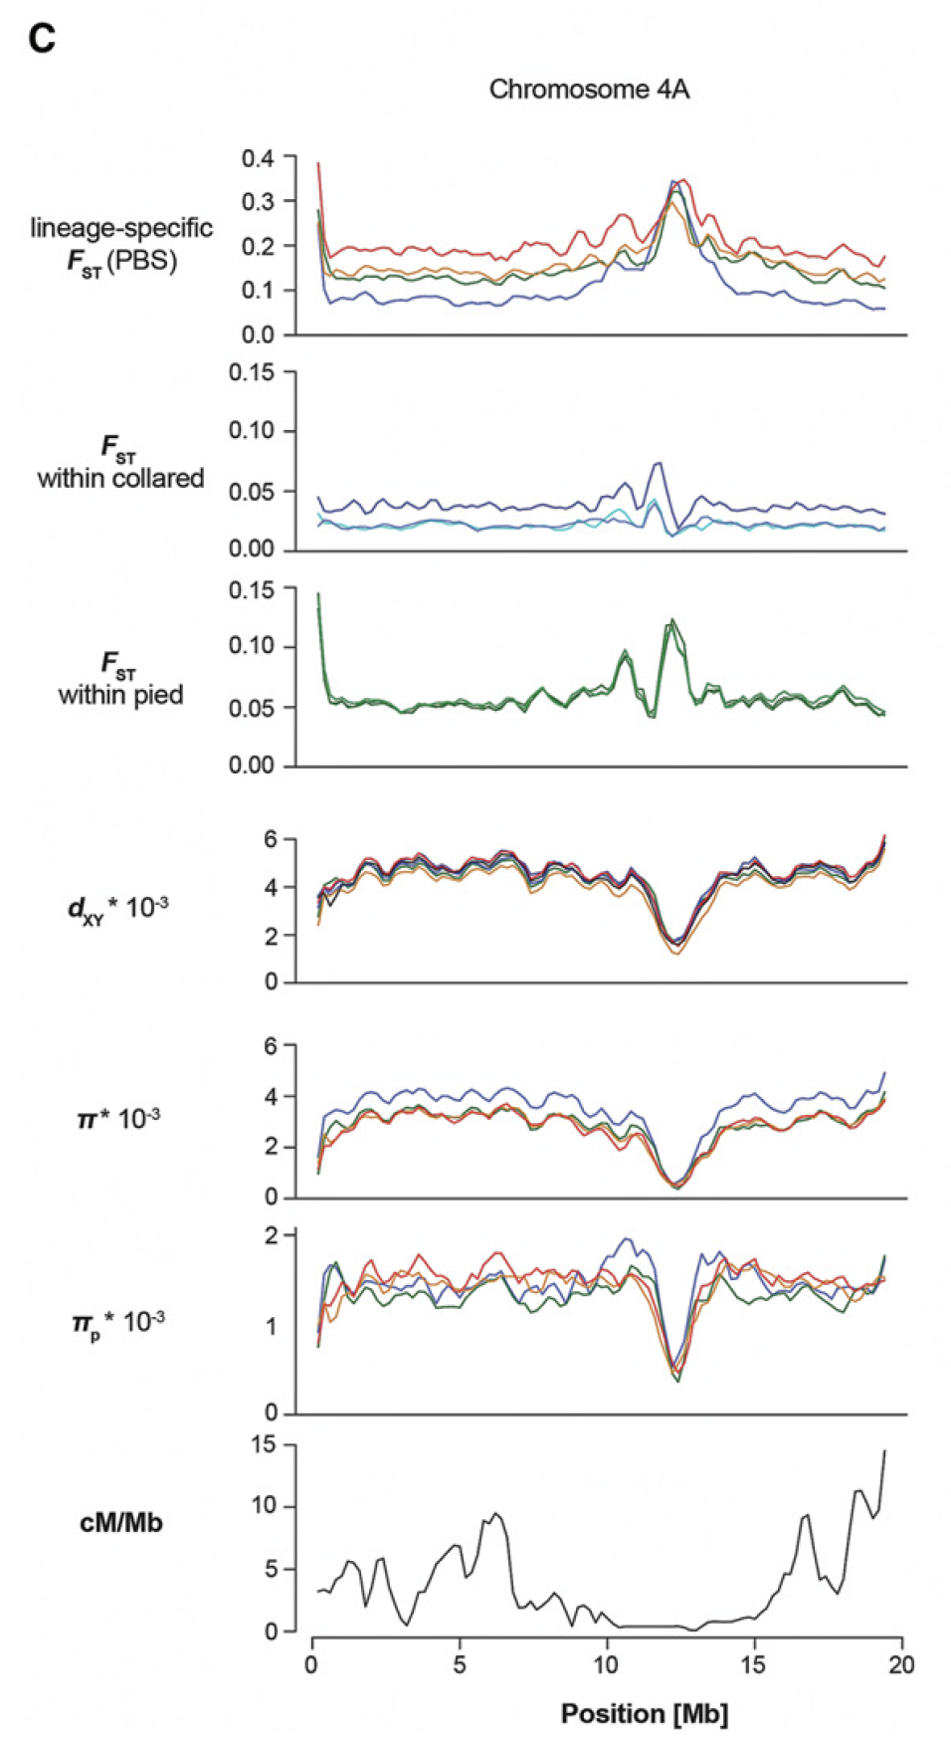
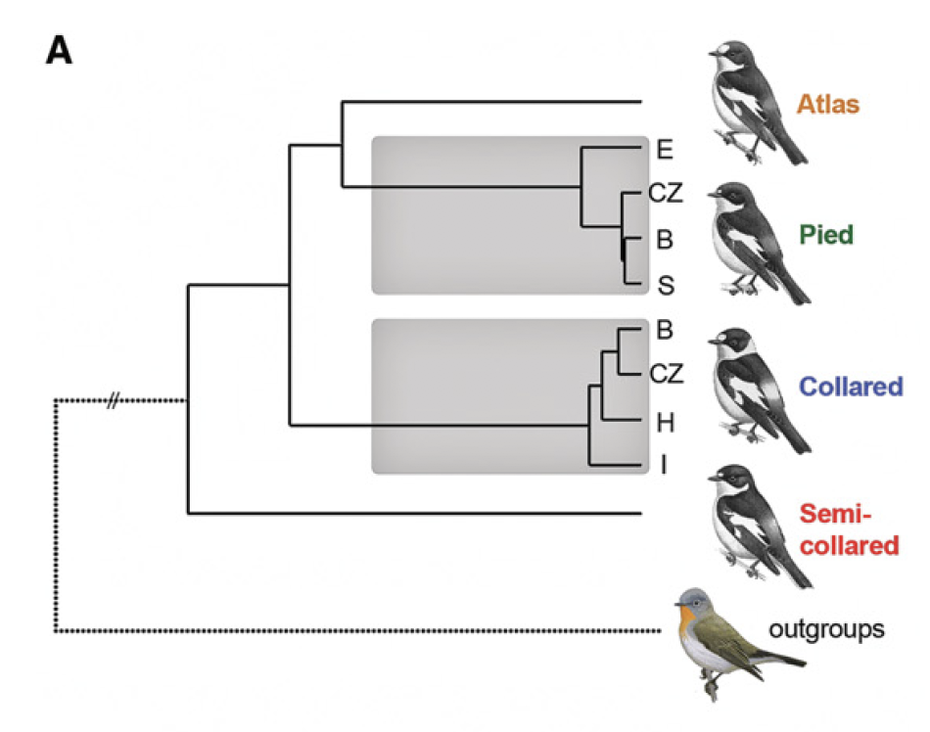
Does this mean that all these species/populations comparisons share the same ‘speciation genes”?

Slide 19
But sequence divergence is actually reduced here…

Slide 20
And nucleotide diversity, too.

Slide 21
Recombination is reduced in the same area.

Slide 22
Adaptation/speciation with gene flow
Positive Selection
Differentiation increases (F_{ST})
Diversity decreases (π)
Island of differentiation

Slide 23

Or background selection without gene flow?
Positive selection?
F_{ST} = (π_{T} –π_{S})/π_{T}
F_{ST} is affected by levels of standing genetic variation:
It is inflated in areas of low diversity
It is low when diversity is high
Differentiation increases (F_{ST})
Low recombination reduces diversity:
Recombination introduces diversity
Recombination reduces the diversity-reducing effect of positive and background selection
Diversity decreases (π)
Island of differentiation

Slide 24
Absolute measures of differentiation
D_{xy} is the average number of pairwise differences between sequences from two populations, excluding all comparisons between sequences within populations.
It is independent of the levels of diversity within the two populations examined.
However, it is affected by ancestral levels of diversity and mutation rate.

Slide 25
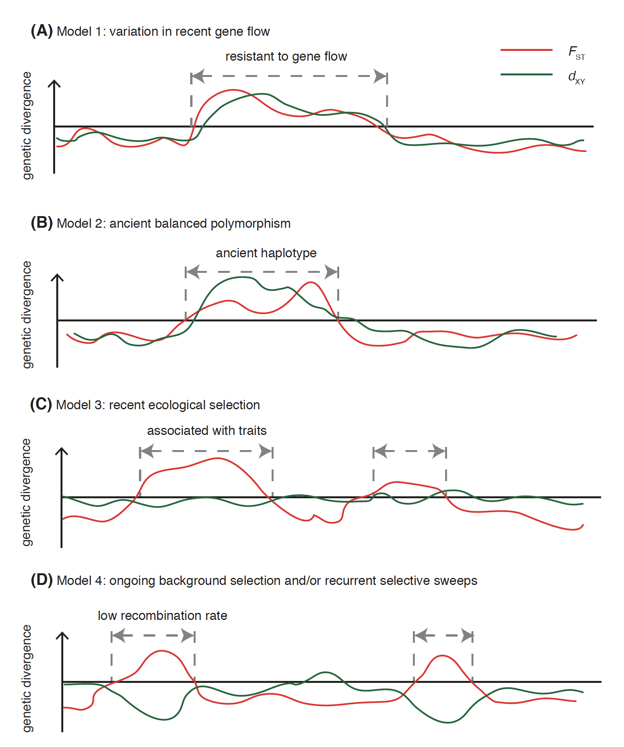
Ideally, knowing recombination rates across the genome would help greatly to disentangle different scenarios.
The joint assessment of different estimators/statistics can help us understand drivers of apparent differentiation.
Han et al. 2017, Genome Research

Slide 26
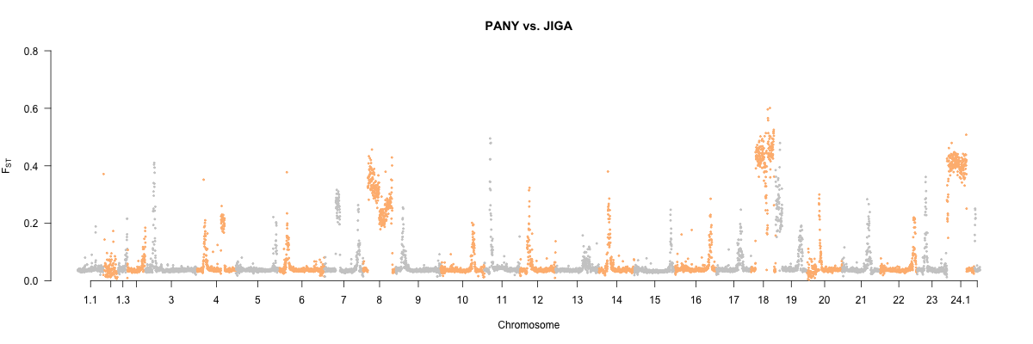
Islands of divergence in the Atlantic silverside
MAQU
MBNS
PANY
Relative differentiation - F_{ST}
JIGA
Tigano et al., in prep.

Slide 27
Islands of divergence in the Atlantic silverside
MAQU
MBNS
PANY
Relative differentiation - F_{ST}
JIGA
Tigano et al., in prep.

Slide 28
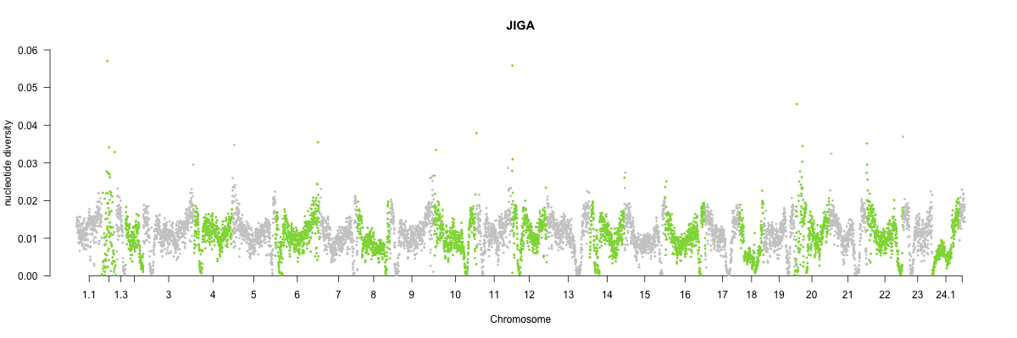
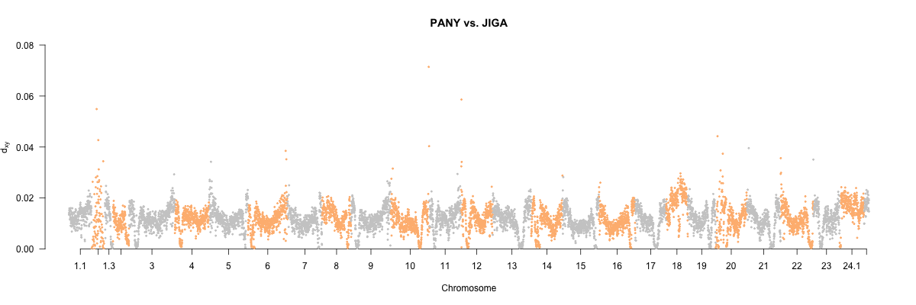
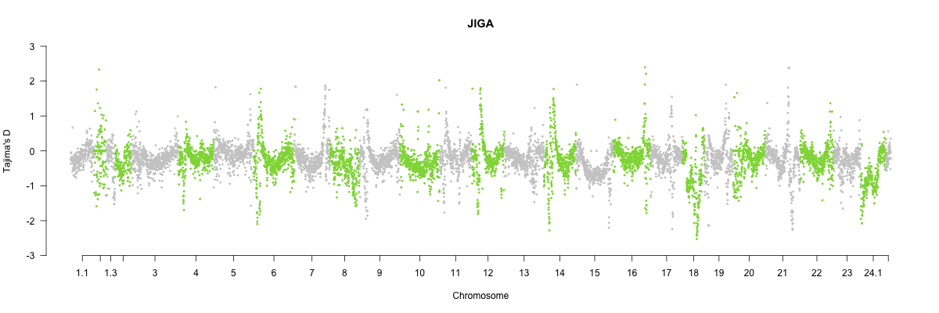
Differentiation
Diversity
Diversity
F_{ST}
π
D_{xy}
Tajima’s D
Tigano et al., in prep.

Slide 29



Differentiation
Diversity
Inversions
Diversity
F_{ST}
π
D_{xy}
Tajima’s D
Tigano et al., in prep.

Slide 30
Differentiation
Diversity
Centromeres?
Diversity
F_{ST}
π
D_{xy}
Tajima’s D
Tigano et al., in prep.

Slide 31
Structural variation
Though we have evidence from clinal analyses and correspondence between phenotypic differences and frequency of those inversions, SVs (including inversions) can be maintained as polymorphism within populations or species by neutral processes.

Slide 32
Structural variation
How structural variation can confound signatures of selection.
Recombination suppression → elevated differentiation due to low recombination rather than selection

Slide 33
Structural variation
How structural variation can confound signatures of selection.
Recombination suppression → elevated differentiation due to low recombination rather than selection
Collapse of paralog sequences (Copy Number Variants) → detection of excess of polymorphism and heterozygosity

Slide 34
Structural variation
How structural variation can confound signatures of selection.
Recombination suppression → elevated differentiation due to low recombination rather than selection
Collapse of paralog sequences (Copy Number Variants) → detection of excess of polymorphism and heterozygosity
Important variants could get filtered out → low quality assembly and mapping

Slide 35
Structural variation
How structural variation can confound signatures of selection.
Recombination suppression → elevated differentiation due to low recombination rather than selection
Collapse of paralog sequences (Copy Number Variants) → detection of excess of polymorphism and heterozygosity
Important variants could get filtered out → low quality assembly and mapping
Missing heritability → if only sequence variation is screened but the variant associated with phenotype/environment in a SV

Slide 36
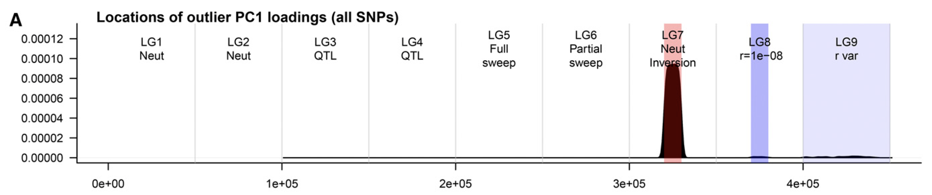
Structural variation
How structural variation can confound signatures of selection.
Neutral demographic model for outlier methods
Lotterhos 2019, G3

Slide 37
The end!

